Slide 1

UEEN 3113 / 3413
Server Configuration and management

Slide 2

Configure Network
Host name is usually set during installation.
Host name is stored in /etc/hostname
Host name is display in the shell prompt, but it may not be the entire host name.
Default prompt shows the hostname only until it reaches the first period.

Slide 3
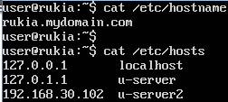
Configure Network
To change host name:
hostnamectl set-hostname new_hostname
change the hostname in /etc/hostname manually
There is another file that we need to update as well, /etc/hosts, which is use to resolve local hostname. hostnamectl does not update /etc/hosts

Slide 4
Configure Network
There might be multiple network interfaces available, to view the IP addresses, run the command ip addr show or ip a or ifconfig (deprecated but still widely used)
To bring down a network interface:
ip link set interface down OR
ifconfig interface down
To bring up a network interface:
ip link set interface up OR
ifconfig interface up

Slide 5

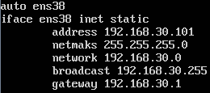
Configure Network
By default, dynamic IP is assigned from a DHCP server.
To assign a static IP to a machine, we need to configure it in /etc/network/interfaces

Slide 6
Configure Network
We need to restart the network service after the configuration is done.
systemctl restart networking.service OR
/etc/init.d/networking restart (on older system)
If we connect via SSH to configure the network, restarting network service will cause the connection terminated (processes will be terminated as well).
tmux (terminal multiplexer), able to keep commands running in the background, even if connection dropped

Slide 7
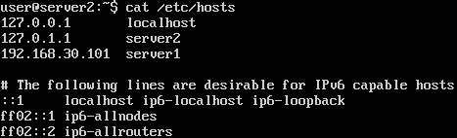
Configure Network
Ubuntu resolves names based on (the default order, specified in /etc/nsswitch.conf)
/etc/hosts
DNS
Adding new server requires /etc/hosts in all machines that need to connect to it to be updated.

Slide 8
DHCP Server
To install dhcp server:
apt-get install isc-dhcp-server
To check the status of dhcp server:
systemctl status isc-dhcp-server
To stop the dhcp server:
systemctl stop isc-dhcp-server
/etc/init.d/isc-dhcp-server stop (for older server)

Slide 9
DHCP Server
It’s better to have a planning on IP scheme, for example
IP range X.X.X.1 – X.X.X.10 reserved for network devices
IP range X.X.X.11 – X.X.X.50 reserved for servers
IP range X.X.X.51 – X.X.X.230 will be assigned to client on request
Each organization might have their own scheme.

Slide 10
DHCP Server
The configuration file with default configuration for DHCP server is /etc/dhcp/dhcpd.conf
It’s better to make a backup copy of this file before we change the configuration.
Common options in dhcpd.conf:
default-lease-time xxx: a device need to renew IP address every xxx seconds, unless it asks for a longer duration.
max-lease-time xxx: a device can’t hold the lease longer than xxx seconds.

Slide 11
DHCP Server
Common options in dhcpd.conf:
option subnet-mask 255.255.255.0: inform clients that their subnet mask should be set to 255.255.255.0 for a default 24-bit network
option broadcast-address X.X.X.255: inform the client to use X.X.X.255 as the broadcast address
option domain-name “mydomain.com”: sett the domain name of all hosts that connect to the server, can leave it as is if we don't have one

Slide 12
DHCP Server
Common options in dhcpd.conf:
authoritative: declare the DHCP server as authoritative to our network
subnet X.X.X.0 netmask 255.255.255.0{…}: specify information that will be provided to clients. For example:
subnet 192.168.30.0 netmask 255.255.255.0{
range 192.168.30.51 192.168.30.230;
option router 192.168.30.1;
option domain-name-servers 192.168.30.1;
}

Slide 13
DHCP Server
To assign which network interfaces should the DHCP server serves the requests, specify the interfaces in /etc/default/isc-dhcp-server, look for the line INTERFACES=“”
Examples
INTERFACES=“enp0s3”
INTERFACES=“eth0”

Slide 14
DHCP Server
Once configured. We can start the dhcp service:
systemctl start isc-dhcp-server
/etc/init.disc-dhcp-server start (for older Ubuntu servers)
When an IP lease is assigned to a client, it will be recorded in /var/lib/dhcp/dhcpd.leases
Information of DHCP server will be stored to system log located at /var/log/syslog

Slide 15
DNS (Domain Name System) Server
Local DNS server allows us to resolve local hostnames based on Zone File which contains IP-host matching.
If our local DNS server is unable to fulfil a request (e.g. external website), the server would pass the request to an external DNS server
First of all, we need to install Berkeley Internet Name Daemon (BIND) and start it
sudo apt install bind9
sudo systemctl start bind9 OR /etc/init.d/bind9 start

Slide 16


DNS (Domain Name System) Server
In order to pass a request to external DNS server, we need to configure the file /etc/bind/named.conf.options
There is a block of configuration named forwarders
Replace 0.0.0.0 with the IP of external DNS server

Slide 17
DNS (Domain Name System) Server
If we are using a separate DNS server, remember to set the IP address in DHCP configuration:
option domain-name-servers X.X.X.X;
To resolve local host, we need to create a zone file and tell bind where to find the file, by adding the following block of code in /etc/bind/named.conf.local
zone "mydomain" IN { type master;
file "/etc/bind/mydomain";
}

Slide 18
DNS (Domain Name System) Server
An example of zone file "/etc/bind/mydomain“:
$TTL 1D
@ IN SOA mydomain. hostmaster.mydomain. (
201803121 ; serial
8H ; refresh
4H ; retry
4W ; expire
1D ) ; minimum
IN A 192.168.1.1
;
@ IN NS mydns.mydomain.
fileserv IN A 192.168.1.3
mailserv IN A 192.168.1.5
mail IN CNAME mailserv.

Slide 19
DNS (Domain Name System) Server
Time to Live (TTL) determines how long a record may be cached within a DNS server.
With the Start of Authority (SOA), the DNS server is authoritative over the mydomain domain.
hostmaster@mydomain (bind format is hostmater.mydomain) as the e-mail address of the responsible party for the DNS server

Slide 20
DNS (Domain Name System) Server
201803121 ; serial
A serial number (any number) to tell bind that the file has been changed. The number must be increased by at least one whenever we make changes to the file.
8H ; refresh
instruct any slave DNS servers have to check for update in zone records in every 8 hours.

Slide 21
DNS (Domain Name System) Server
4H ; retry
dictates how long the slave will wait to check in, in case there was an error doing so the last time
4W ; expire
maximum age of the zone file
1D ) ; minimum
minimum age of the zone file

Slide 22
DNS (Domain Name System) Server
IN A 192.168.1.1
@ IN NS mydns.mydomain.
Identify the server itself, named mydns at IP 192.168.1.1
fileserv IN A 192.168.1.3
mailserv IN A 192.168.1.5
mail IN CNAME mailserv.
A list of hosts and their IP addresses.
mail is a Canonical Name (CNAME) record, points back to mailserv. Access to mail will be redirected to mailserv.

Slide 23

DNS (Domain Name System) Server
To set up a secondary DNS server, edit the /etc/bind/named.conf.options to allow zone transfer to secondary DNS server.

Slide 24
DNS (Domain Name System) Server
On the secondary DNS server, edit the /etc/bind/named.conf.options to create a zone entry.
zone "mydomain" IN { type slave;
master { 192.168.30.1; };
file "/var/lib/bind/mydomain";
}

Slide 25
DNS (Domain Name System) Server
We need to inform client to use the secondary DNS server as well.
Edit the dhcp server configuration file /etc/dhcp/dhcpd.conf to include the IP address of secondary DNS server at line
option domain-name-servers DNS_1_IP, DNS_2_IP;

Slide 26
SSH (Secure Shell)
A suite of network communication tools that allows users to connect to a remote server with encrypted session.
There are 2 packages for SSH in Ubuntu (other distributions might use different name for the packages):
openssh-server
openssh-client (usually installed by default)
We will install openssh-server in the server.
Any client that needs to connect to server using SSH must install openssh-client.

Slide 27
SSH (Secure Shell)
To check if the SSH server is running / installed:
service ssh status OR
systemctl status ssh OR
which sshd
If SSH is disabled, we can enable it by:
systemctl enable ssh

Slide 28
SSH (Secure Shell)
To check the listening port (default port is 22):
netstat -tulpn | grep ssh
To connect to server / other machine, using currently logged in username:
ssh host_name OR ssh ip_address
Example: ssh u-server

Slide 29
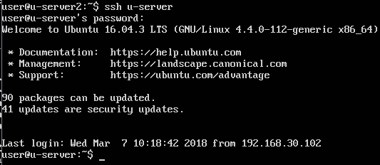
SSH (Secure Shell)
To connect with other username:
ssh username@host_name OR ssh username@ip_address

Slide 30
SSH (Secure Shell)
If the ssh is listening to a non-standard port (other than 22), we need to specify the port number with the -p option.
ssh -p port_number username@hostname
Example, ssh –p 13300 user2@u-server
To disconnect: enter the exit command or press Ctrl+D.
If we started background processes on target machine via ssh, use Ctrl+D to end the session, otherwise the processes will be terminated.

Slide 31
SSH (Secure Shell)
Notice that we are asked for password when we connect to server / machine, which means the password will be transmitted during the connecting process. (Is this risky?)
It’s better to disable password authentication and implement Public Key Authentication.

Slide 32
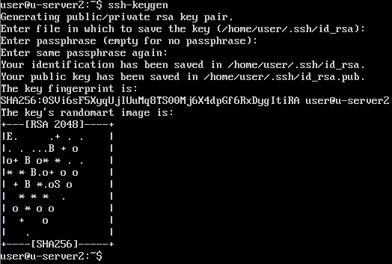
SSH (Secure Shell)
First, we nee to generate a public/private key pair .
ssh-keygen

Slide 33
SSH (Secure Shell)
The passphrase can be empty but it’s recommended to provide one, which should be different from system password.
2 files will be generated and stored in the default directory (/home/user_name/.ssh)
id_rsa (private key)
id_rsa.pub (public key)
Private key (id_rsa) should never leave the machine, be given to someone or stored on external storage media.

Slide 34
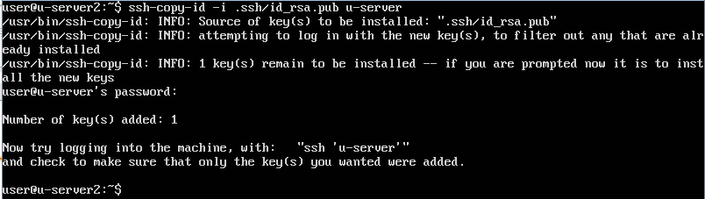
SSH (Secure Shell)
The public key is to be copied to target servers / machines that we wish to connect to using ssh.
ssh-copy-id -i ~/.ssh/id_rsa.pub host_name
Example: ssh-copy-id -i ~/.ssh/id_rsa.pub u-server

Slide 35
SSH (Secure Shell)
In the target server / machine, .ssh directory will be created to store the public key in a file named authorized_keys
If we connect from multiple machines (a key is generated by each machine), additional keys will be appended to the bottom of this file, one per line.

Slide 36
SSH (Secure Shell)
To simplify ssh connection, we can create a config file in .ssh directory to store all necessary information for ssh connection.
nano ~/.ssh/config
Content of config file:
host host_name (host_name here serves as shortcut)
Hostname actual_host_name OR ip_address
Port port_number
User user_name

Slide 37
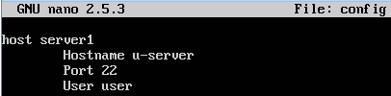
SSH (Secure Shell)
Example of config file:
host server1
Hostname u-server
Port 22
User user
To connect to u-server, with config file created:
ssh server1

Slide 38
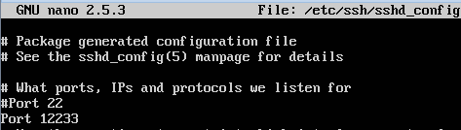
SSH (Secure Shell)
Configuration file for ssh daemon is /etc/ssh/sshd_config
It’s safer to create a backup copy of the configuration file before we change the configuration.
Some suggestions to secure the ssh
Change the port number (preferably a high number that's above 10000 and not in use by any other service).

Slide 39
SSH (Secure Shell)
Some suggestions to secure the ssh
Change the port number (preferably a high number that's above 10000 and not in use by any other service).
Make sure that ssh is listening to Protocol 2 (should be default in newer server)
Allow only specified users / groups to connect via ssh (by default every user created is allowed) by adding the following sections in config
AllowUsers users_separated_by_a_space
AllowGroups groups_separated_by_a_space

Slide 40

SSH (Secure Shell)
Some suggestions to secure the ssh
Examples for AllowUsers and AllowGroups
AllowUsers user user2 john
AllowGroups admins sshuser
Turn off PermitRootLogin
Default setting is prohibit-password, means key authentication is allowed for root but passwords for root aren't accepted
To turn off, replace prohibit-password with no

Slide 41
SSH (Secure Shell)
Some suggestions to secure the ssh
Disable password authentication after key authentication has been setup successfully
Restart the ssh service whenever we change the configuration.
systemctl restart ssh

Slide 42
SSH (Secure Shell)
If firewall is enable, make sure that we enable traffic via SSH.
To check if firewall is enabled and running in Ubuntu:
sudo ufw status
To allow traffic from specific machine to SSH port (TCP and UDP):
ufw allow from ip_address to any port port_number
To allow traffic from a subnet:
ufw allow from subnet to any port port_number

Slide 43


